Slide 1


Slide 2

Understanding C++ coroutines by example part 1
Pavel Novikov
@cpp_ape

Slide 3
No decent user facing support in C++20
Use cppcoro by Lewis Baker *
https://github.com/lewissbaker/cppcoro

Slide 4
Thanks for coming!

Slide 5


Slide 6
Gameplan
Iteration 0: my first coroutine
What is a C++ coroutine?
Demystifying compiler magic
Iteration 1: awaiting tasks
Making tasks awaitable
Writing awaitable types
Iteration 2:
Getting tasks result
Thread safety
Analysis of the approach

Slide 7
Iteration 0: my first coroutine
Task<int> foo() {
co_return 42;
}
A function is a coroutine if it contains one of these:
co_return (coroutine return statement)
co_await (await expression)
co_yield (yield expression)

Slide 8
What is a C++ coroutine?
routine
Coroutine taxonomy
subroutine
coroutine
stackfull
(fiber)
stackless

Slide 9
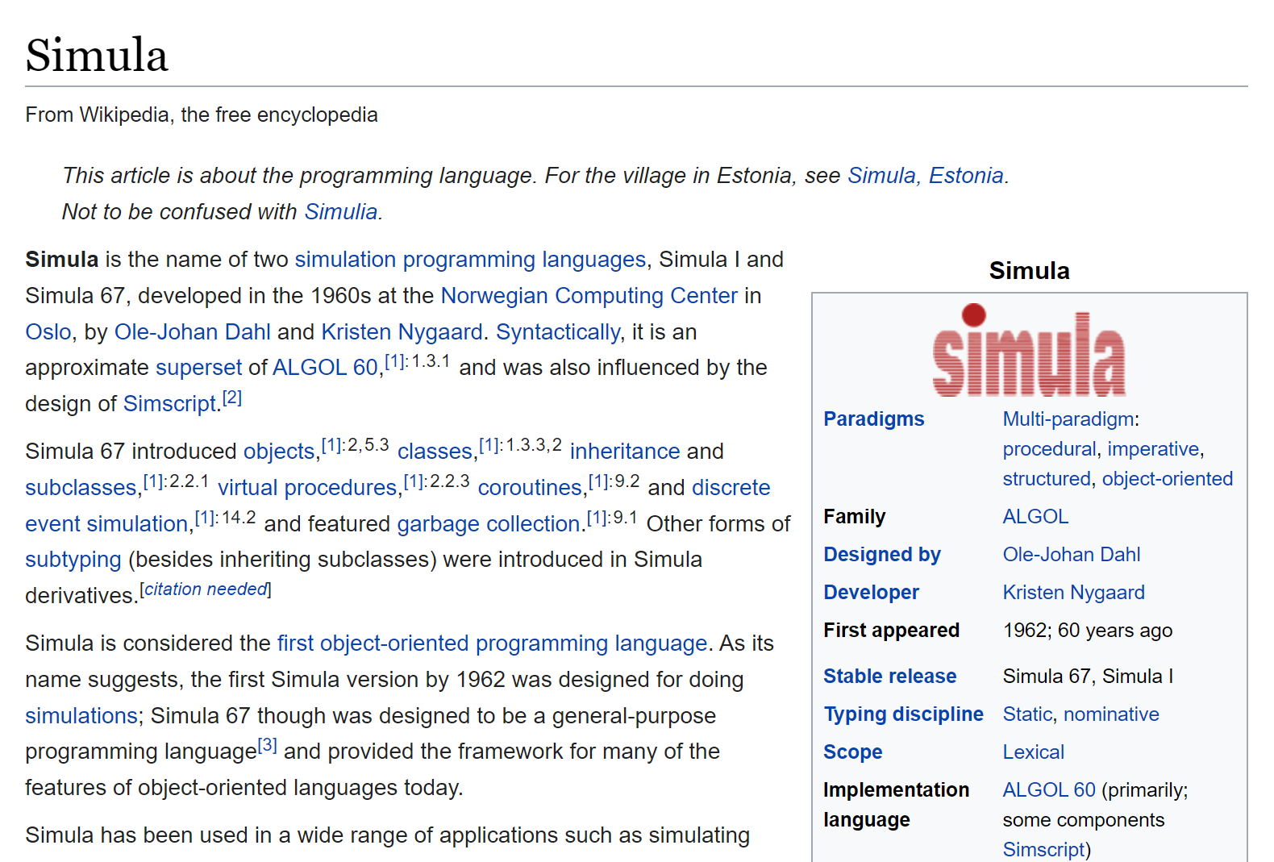
What is a C++ coroutine?

Slide 10
What is a C++ coroutine?
Task<int> foo() {
co_return 42;
}
A coroutine behaves as if its function-body were replaced by:
{
promise-type promise promise-constructor-arguments ;
try {
co_await promise.initial_suspend() ;
function-body
} catch ( ... ) {
if (!initial-await-resume-called)
throw ;
promise.unhandled_exception() ;
}
final-suspend :
co_await promise.final_suspend() ;
}
foo()
foo() body
initial suspend
final suspend

Slide 11

What is a C++ coroutine?
Task<int> foo() {
co_return 42;
}
A coroutine behaves as if its function-body were replaced by:
{
promise-type promise promise-constructor-arguments ;
try {
co_await promise.initial_suspend() ;
function-body
} catch ( ... ) {
if (!initial-await-resume-called)
throw ;
promise.unhandled_exception() ;
}
final-suspend :
co_await promise.final_suspend() ;
}
foo()
foo() body
initial suspend
final suspend

Slide 12
Transformation by the compiler
Task<int> foo() {
struct CoroFrame {
Task<int>::promise_type promise;
bool initial_await_resume_called = false;
int state = 0;
void operator()() {
co_return 42;
}
};
auto coroFrame = new CoroFrame;
auto returnObject{ coroFrame->promise.get_return_object() };
(*coroFrame)();
return returnObject;
}
Task<int> foo() {
co_return 42;
}
original code
transformed code

Slide 13
Transformation by the compiler
Task<int> foo() {
struct CoroFrame {
Task<int>::promise_type promise;
bool initial_await_resume_called = false;
int state = 0;
void operator()() {
try {
co_await promise.initial_suspend();
co_return 42;
}
catch (...) {
if (!initial_await_resume_called)
throw;
promise.unhandled_exception();
}
final_suspend:
co_await promise.final_suspend();
}
};
auto coroFrame = new CoroFrame;
auto returnObject{ coroFrame->promise.get_return_object() };
(*coroFrame)();
return returnObject;
}
Task<int> foo() {
co_return 42;
}
Task<int> foo() {
struct CoroFrame {
Task<int>::promise_type promise;
bool initial_await_resume_called = false;
int state = 0;
void operator()() { /*...*/ }
};
auto coroFrame = new CoroFrame;
auto returnObject{ coroFrame->promise.get_return_object() };
(*coroFrame)();
return returnObject;
}
coroutine frame

Slide 14

Transformation by the compiler
Task<int> foo() {
struct CoroFrame {
Task<int>::promise_type promise;
bool initial_await_resume_called = false;
int state = 0;
void operator()() {
try {
co_await promise.initial_suspend();
co_return 42;
}
catch (...) {
if (!initial_await_resume_called)
throw;
promise.unhandled_exception();
}
final_suspend:
co_await promise.final_suspend();
}
};
auto coroFrame = new CoroFrame;
auto returnObject{ coroFrame->promise.get_return_object() };
(*coroFrame)();
return returnObject;
}
Task<int> foo() {
co_return 42;
}
void operator()() {
try {
co_await promise.initial_suspend();
co_return 42;
}
catch (...) {
if (!initial_await_resume_called)
throw;
promise.unhandled_exception();
}
final_suspend:
co_await promise.final_suspend();
}

Slide 15
Transformation by the compiler
Task<int> foo() {
struct CoroFrame {
Task<int>::promise_type promise;
bool initial_await_resume_called = false;
int state = 0;
void operator()() {
try {
co_await promise.initial_suspend();
promise.return_value(42); goto final_suspend;
}
catch (...) {
if (!initial_await_resume_called)
throw;
promise.unhandled_exception();
}
final_suspend:
co_await promise.final_suspend();
}
};
auto coroFrame = new CoroFrame;
auto returnObject{ coroFrame->promise.get_return_object() };
(*coroFrame)();
return returnObject;
}
Task<int> foo() {
co_return 42;
}
void operator()() {
try {
co_await promise.initial_suspend();
promise.return_value(42); goto final_suspend;
}
catch (...) {
if (!initial_await_resume_called)
throw;
promise.unhandled_exception();
}
final_suspend:
co_await promise.final_suspend();
}

Slide 16
Transformation by the compiler
Task<int> foo() {
struct CoroFrame {
Task<int>::promise_type promise;
bool initial_await_resume_called = false;
int state = 0;
void operator()() {
try {
co_await promise.initial_suspend();
promise.return_value(42); goto final_suspend;
}
catch (...) {
if (!initial_await_resume_called)
throw;
promise.unhandled_exception();
}
final_suspend:
co_await promise.final_suspend();
}
};
auto coroFrame = new CoroFrame;
auto returnObject{ coroFrame->promise.get_return_object() };
(*coroFrame)();
return returnObject;
}
Task<int> foo() {
co_return 42;
}
Sequence of operations:
Task<int>::promise_type promise;
promise.get_return_object();
promise.initial_suspend();
promise.return_value(42);
promise.unhandled_exception();
promise.final_suspend();

Slide 17
Task type
template<typename T> struct Promise;
template<typename T>
struct [[nodiscard]] Task {
using promise_type = Promise<T>;
Task() = default;
private:
explicit Task(Promise<T> *promise) : promise{ promise } {}
PromisePtr<T> promise = nullptr;
template<typename> friend struct Promise;
};
struct CoroDeleter {
template<typename Promise>
void operator()(Promise *promise) const noexcept {
using CoroHandle = std::coroutine_handle<Promise>;
CoroHandle::from_promise(*promise).destroy();
}
};
template<typename T>
using PromisePtr = std::unique_ptr<Promise<T>, CoroDeleter>;

Slide 18
Task type
template<typename T> struct Promise;
template<typename T>
struct [[nodiscard]] Task {
using promise_type = Promise<T>;
Task() = default;
private:
explicit Task(Promise<T> *promise) : promise{ promise } {}
PromisePtr<T> promise = nullptr;
template<typename> friend struct Promise;
};

Slide 19
Promise type
template<typename T>
struct Promise {
Task<T> get_return_object() noexcept { return Task<T>{ this }; }
std::suspend_never initial_suspend() noexcept { return {}; }
std::suspend_always final_suspend() noexcept { return {}; }
template<typename U>
void return_value(U &&value)
noexcept(std::is_nothrow_constructible_v<T, decltype(std::forward<U>(value))>);
void unhandled_exception()
noexcept(std::is_nothrow_constructible_v<std::exception_ptr, std::exception_ptr>);
bool isReady() const noexcept { return result.index() != 0; }
T &&getResult();
std::variant<std::monostate, T, std::exception_ptr> result;
};
void return_value(U &&value)
noexcept(std::is_nothrow_assignable_v<decltype(result), decltype(std::forward<U>(value))>)
{
result.template emplace<1>(std::forward<U>(value));
}
void unhandled_exception()
noexcept(std::is_nothrow_assignable_v<decltype(result), std::exception_ptr>)
{
result.template emplace<2>(std::current_exception());
}
Task<int> foo() {
struct CoroFrame {
Task<int>::promise_type promise;
//...
};
auto coroFrame = new CoroFrame;
auto returnObject = coroFrame->promise.get_return_object();
(*coroFrame)();
return returnObject;
}
void operator()() {
try {
//...
}
catch (...) {
//...
promise.unhandled_exception();
}
final_suspend:
co_await promise.final_suspend();
}
foo()
foo() body
T &&getResult() {
if (result.index() == 2)
std::rethrow_exception(std::get<2>(result));
return std::move(std::get<1>(result));
}
void operator()() {
try {
co_await promise.initial_suspend();
promise.return_value(42); goto final_suspend;
}
catch (...) { /*...*/ }
final_suspend:
co_await promise.final_suspend();
}
initial suspend
final suspend

Slide 20
Iteration 0: my first coroutine
Task<int> foo() {
std::cout << "foo(): about to return\n";
co_return 42;
}
auto task = foo();
output:
foo(): about to return

Slide 21
Iteration 0: my first coroutine
void operator()() {
try {
co_await promise.initial_suspend();
promise.return_void(); goto final_suspend;
}
catch (...) { /*...*/ }
final_suspend:
co_await promise.final_suspend();
}
Task<void> foo() {
co_return;
}
template<typename T>
struct Promise {
//...
void return_void() noexcept;
//...
};

Slide 22

Let's recap
A promise_type is used to communicate with the compiler backend.
Task<int> foo() {
co_return 42;
}
Task<int>::promise_type promise;
promise.get_return_object();
promise.initial_suspend();
promise.return_value(42);
promise.unhandled_exception();
promise.final_suspend();

Slide 23
Iteration 1: awaiting tasks
Task<int> bar() {
const auto result = foo();
const int i = co_await result;
co_return i + 23;
}

Slide 24
Awaiting: rough idea
co_await result;
auto awaitable{ getAwaitable(result) };
if (!awaitable.await_ready()) {
awaitable.await_suspend(thisCoroHandle);
// suspend coroutine
}
resume:
awaitable.await_resume();

Slide 25
Transformation by the compiler
Task<int> bar() {
const auto result = foo();
const int i = co_await result;
co_return i + 23;
}
Task<int> bar() {
struct CoroFrame {
Task<int>::promise_type promise;
bool initial_await_resume_called = false;
int state = 0;
//...
void operator()();
};
auto coroFrame = new CoroFrame;
auto returnObject{
coroFrame->promise.get_return_object()
};
(*coroFrame)();
return returnObject;
}
transformed code
original code

Slide 26

Transformation by the compiler
struct CoroFrame {
Task<int>::promise_type promise;
bool initial_await_resume_called = false;
int state = 0;
//...
void operator()();
};
void operator()() {
try {
switch (state)
{
case 0:
break;
case 1:
goto initialResume;
case 2:
goto resume2;
default:
break; //bad
}
//...

Slide 27
Transformation by the compiler
struct CoroFrame {
Task<int>::promise_type promise;
bool initial_await_resume_called = false;
int state = 0;
std::optional<Awaitable0> awaitable0;
//...
void operator()();
};
void operator()() {
//...
state = 1;
awaitable0 ??? getAwaitable(promise.initial_suspend());
if (!awaitable0->await_ready()) {
awaitable0->await_suspend(thisCoroHandle);
// suspend
return;
}
initialResume:
initial_await_resume_called = true;
awaitable0->await_resume();
//...
co_await promise.initial_suspend();

Slide 28
Transformation by the compiler
void operator()() {
//...
state = 1;
awaitable0.emplace(getAwaitable(promise.initial_suspend());
if (!awaitable0->await_ready()) {
awaitable0->await_suspend(thisCoroHandle);
// suspend
return;
}
initialResume:
initial_await_resume_called = true;
awaitable0->await_resume();
//...
co_await promise.initial_suspend();
struct suspend_never {
bool await_ready() noexcept {
return true;
}
void await_suspend(coroutine_handle<>) noexcept {}
void await_resume() noexcept {}
};

Slide 29
Transformation by the compiler
const auto result = foo();
const int i = co_await result;
void operator()() {
//...
const auto result = foo();
state = 2;
awaitable1.emplace(getAwaitable(result));
if (!awaitable1->await_ready() {
auto coro = awaitable1->await_suspend(thisCoroHandle);
// suspend
coro();
return;
}
resume2:
const int i = awaitable1->await_resume();
//...
current coroutine to suspend
struct Awaitable {
bool await_ready() const noexcept;
using CoroHandle = std::coroutine_handle<>;
CoroHandle await_suspend(CoroHandle) const noexcept;
T &&await_resume() const;
};
symmetric control transfer
returned coroutine is resumed

Slide 30
Transformation by the compiler
const auto result = foo();
const int i = co_await result;
struct CoroFrame {
Task<int>::promise_type promise;
bool initial_await_resume_called = false;
int state = 0;
std::optional<Awaitable0> awaitable0;
std::optional<Awaitable1> awaitable1;
void operator()();
};
void operator()() {
//...
const auto result = foo();
state = 2;
awaitable1.emplace(getAwaitable(result));
if (!awaitable1->await_ready() {
auto coro = awaitable1->await_suspend(thisCoroHandle);
// suspend
coro();
return;
}
resume2:
const int i = awaitable1->await_resume();
//...

Slide 31
Transformation by the compiler
co_return i + 23;
void operator()() {
//...
const int i = awaitable1->await_resume();
promise.return_value(i + 23); goto final_suspend;
}
catch (...) {
if (!initial_await_resume_called)
throw;
promise.unhandled_exception();
}
final_suspend:
//...

Slide 32
Transformation by the compiler
co_await promise.final_suspend();
void operator()() {
//...
final_suspend:
auto finalAwaitable{ getAwaitable(promise.final_suspend()) };
if (!finalAwaitable.await_ready()) {
finalAwaitable.await_suspend(thisCoroHandle);
return;
}
delete this;
}
struct suspend_always {
bool await_ready() noexcept {
return false;
}
void await_suspend(coroutine_handle<>) noexcept {}
void await_resume() noexcept {}
};

Slide 33
Awaiting: Task
template<typename T>
struct [[nodiscard]] Task {
using promise_type = Promise<T>;
Task() = default;
auto operator co_await() const noexcept;
private:
explicit Task(Promise<T> *promise) : promise{ promise } {}
PromisePtr<T> *promise = nullptr;
template<typename> friend struct Promise;
};

Slide 34
Task::operator co_await
auto operator co_await() const noexcept {
struct Awaitable {
//...
Promise<T> &promise;
};
return Awaitable{ *promise };
}

Slide 35
Task::operator co_await
struct Awaitable {
bool await_ready() const noexcept {
return promise.isReady();
}
using CoroHandle = std::coroutine_handle<>;
CoroHandle await_suspend(CoroHandle continuation) const noexcept {
promise.continuation = continuation;
return std::coroutine_handle<Promise<T>>::from_promise(promise);
}
T &&await_resume() const {
return promise.getResult();
}
Promise<T> &promise;
};
symmetric control transfer
current coroutine is suspended and becomes the continuation
suspended coroutine is returned and resumed

Slide 36
Awaiting: Promise
template<typename T>
struct Promise {
//...
// std::suspend_always final_suspend() noexcept { return {}; }
auto final_suspend() noexcept {
struct FinalAwaitable { /*...*/ };
return FinalAwaitable{};
}
//...
std::variant<std::monostate, T, std::exception_ptr> result;
std::coroutine_handle<> continuation;
};

Slide 37
Awaiting: Promise
template<typename T>
struct Promise {
//...
// std::suspend_always final_suspend() noexcept { return {}; }
auto final_suspend() noexcept {
struct FinalAwaitable { /*...*/ };
return FinalAwaitable{};
}
//...
std::variant<std::monostate, T, std::exception_ptr> result;
std::coroutine_handle<> continuation;
};
struct FinalAwaitable {
bool await_ready() const noexcept { return false; }
void await_suspend(std::coroutine_handle<Promise<T>> thisCoro) noexcept {
auto &promise = thisCoro.promise();
if (promise.continuation)
promise.continuation();
}
void await_resume() const noexcept {}
};

Slide 38

Iteration 1: awaiting tasks
Task<int> bar() {
const auto result = foo();
std::cout << "bar(): about to co_await\n";
const int i = co_await result;
std::cout << "bar(): about to return\n";
co_return i + 23;
}
auto task = bar();
output:
foo(): about to return
bar(): about to co_await
bar(): about to return

Slide 39

Helpful tip
Write constructor and destructor for promise types.
template<typename T>
struct Promise {
Promise() {
std::cout << "Promise: ctor\n";
}
~Promise() {
std::cout << "Promise: dtor\n";
}
//...

Slide 40
Writing an awaitable
struct Sleep {
bool await_ready() const noexcept {
return duration == duration.zero();
}
void await_suspend(std::coroutine_handle<> coro) const {
std::this_thread::sleep_for(duration);
coro();
}
void await_resume() const noexcept {}
std::chrono::milliseconds duration;
};
suspended coroutine
puts thread to sleep
resumes the suspended coroutine

Slide 41

Writing an awaitable
Task<void> sleepy() {
std::cout << "sleepy(): about to sleep\n";
co_await Sleep{ std::chrono::seconds{ 1 } };
std::cout << "sleepy(): about to return\n";
}
auto task = sleepy();
output:
Promise: ctor
sleepy(): about to sleep
sleepy(): about to return
Promise: dtor
Well that just sounds like std::this_thread::sleep_for()
with extra steps

Slide 42
Asyncronously reading a file
struct AsyncReadFile {
AsyncReadFile(std::filesystem::path path) :
path{ std::move(path) } {}
bool await_ready() const noexcept { return false; }
void await_suspend(std::coroutine_handle<> coro);
std::string await_resume() noexcept {
return std::move(result);
}
private:
std::filesystem::path path;
std::string result;
};

Slide 43
Asyncronously reading a file
void await_suspend(std::coroutine_handle<> coro) {
auto work = [this, coro]() {
std::cout << tid << " worker thread: opening file\n";
auto stream = std::ifstream{ path };
std::cout << tid << " worker thread: reading file\n";
result.assign(std::istreambuf_iterator<char>{stream},
std::istreambuf_iterator<char>{});
std::cout << tid << " worker thread: resuming coro\n";
coro();
std::cout << tid << " worker thread: exiting\n";
};
std::thread{ work }.detach();
}

Slide 44
Asyncronously reading a file
void await_suspend(std::coroutine_handle<> coro) {
auto work = [this, coro]() {
std::cout << tid << " worker thread: opening file\n";
auto stream = std::ifstream{ path };
std::cout << tid << " worker thread: reading file\n";
result.assign(std::istreambuf_iterator<char>{stream},
std::istreambuf_iterator<char>{});
std::cout << tid << " worker thread: resuming coro\n";
coro();
std::cout << tid << " worker thread: exiting\n";
};
std::thread{ work }.detach();
}

Slide 45
Asyncronously reading a file
Task<size_t> readFile() {
std::cout << tid << " readFile(): about to read file async\n";
const auto result = co_await AsyncReadFile{ "main.cpp" };
std::cout << tid << " readFile(): about to return (size "
<< result.size() << ")\n";
co_return result.size();
}
int main() {
auto task = readFile();
}
output:
Promise: ctor
(tid=38216) readFile(): about to read file async
Promise: dtor

Slide 46
Asyncronously reading a file
Thread A
Task<size_t> readFile() {
const auto result =
co_await AsyncReadFile{ "main.cpp" };
co_return contents.size();
}
exit(0);
Thread B
auto work = [this, coro]() {
//...
coro();
//...
};
coroutine is suspended

Slide 47
Iteration 2
In which we learn how to get result out of a task and
make awaiting thread-safeish

Slide 48
Getting result from task
template<typename T>
struct [[nodiscard]] Task {
//...
private:
//...
PromisePtr<T> promise;
};
Where is the result?
auto task = bar();
template<typename T>
struct Promise {
//...
std::variant<std::monostate, T, std::exception_ptr> result;
std::coroutine_handle<> continuation;
};

Slide 49
Getting result from task
Thread A
auto task = baz();
//...
// are we there yet?
auto result =
getResult(task);
Thread B
continues to execute on thread B
Task<void> baz() {
//...
co_return;
}

Slide 50
Getting result from task
Thread A
auto task = baz();
std::future<void> result;
result.get();
Thread B
continues to execute on thread B
Task<void> baz() {
//...
co_return;
}
std::promise<void> promise;
promise.set_value();
continuation

Slide 51
Getting result from task
template<typename T>
SyncWaitImpl<ResultOfAwait<T&&>> syncWaitImpl(T &&task) {
co_return co_await std::forward<T>(task);
}
template<typename T>
auto syncWait(T &&task) {
return syncWaitImpl(std::forward<T>(task))
.result.get();
}

Slide 52
Getting result from task
template<typename T>
struct SyncWaitImpl {
struct promise_type {
//...
};
std::future<T> result;
};
template<typename T>
auto syncWait(T &&task) {
return syncWaitImpl(std::forward<T>(task))
.result.get();
}

Slide 53
Getting result from task
struct promise_type {
SyncWaitImpl get_return_object() {
return { promise.get_future() };
}
std::suspend_never initial_suspend() noexcept { return {}; }
std::suspend_never final_suspend() noexcept { return {}; }
void return_value(T &&value) {
promise.set_value(std::move(value));
}
void unhandled_exception() {
promise.set_exception(std::current_exception());
}
std::promise<T> promise;
};

Slide 54
Getting result from task
auto task = bar();
auto result = syncWait(task);

Slide 55
Getting result from task
Task<int> foo() {
std::cout << "foo(): about to return\n";
co_return 42;
}
Task<int> bar() {
const auto result = foo();
std::cout << "bar(): about to co_await\n";
const int i = co_await result;
std::cout << "bar(): about to return\n";
co_return i + 23;
}
auto result = syncWait(bar());

Slide 56

Making awaiting thread-safeish
Task<T> Promise<T>
std::atomic<U>
compare_exchange_strong
exchange

Slide 57
Making awaiting thread-safeish
template<typename T>
struct Promise {
//...
auto final_suspend() noexcept {
struct FinalAwaitable { /*...*/ };
return FinalAwaitable{};
}
//...
bool isReady() const noexcept;
//...
std::variant<std::monostate, T, std::exception_ptr> result;
std::coroutine_handle<> continuation;
enum class State { Started, AttachedContinuation, Finished };
std::atomic<State> state = { State::Started };
};
enum class State {
Started,
AttachedContinuation,
Finished
};
std::atomic<State> state = { State::Started };

Slide 58
Making awaiting thread-safeish
template<typename T>
struct Promise {
//...
auto final_suspend() noexcept {
struct FinalAwaitable { /*...*/ };
return FinalAwaitable{};
}
//...
bool isReady() const noexcept;
//...
std::variant<std::monostate, T, std::exception_ptr> result;
std::coroutine_handle<> continuation;
enum class State { Started, AttachedContinuation, Finished };
std::atomic<State> state = { State::Started };
};
struct FinalAwaitable {
bool await_ready() const noexcept { return false; }
void await_suspend(std::coroutine_handle<Promise<T>> thisCoro) noexcept {
auto &promise = thisCoro.promise();
const auto oldState = promise.state.exchange(State::Finished);
if (oldState == State::AttachedContinuation)
promise.continuation();
}
void await_resume() const noexcept {}
};

Slide 59
Making awaiting thread-safeish
template<typename T>
struct Promise {
//...
auto final_suspend() noexcept {
struct FinalAwaitable { // };
return FinalAwaitable{};
}
//...
bool isReady() const noexcept;
//...
std::variant<std::monostate, T, std::exception_ptr> result;
std::coroutine_handle<> continuation;
enum class State { Started, AttachedContinuation, Finished };
std::atomic<State> state = { State::Started };
};
bool isReady() const noexcept {
// return result.index() != 0;
return state == State::Finished;
}

Slide 60
Making awaiting thread-safeish
template<typename T>
struct [[nodiscard]] Task {
//...
using Coro = std::coroutine_handle<>;
bool await_suspend(Coro continuation) const noexcept {
using State = typename Promise<T>::State;
promise.continuation = continuation;
auto expectedState = State::Started;
return promise.state
.compare_exchange_strong(expectedState,
State::AttachedContinuation);
}
//...
};
If state was Started compare-exchange succeeds returning true → coroutine is suspended | If state was Finished compare-exchange fails returning false → coroutine is not suspended

Slide 61

Iteration 2
Task<size_t> readFile() {
std::cout << tid << " readFile(): about to read file async\n";
const auto result = co_await AsyncReadFile{ "main.cpp" };
std::cout << tid << " readFile(): about to return (size "
<< result.size() << ")\n";
co_return result.size();
}
int main() {
auto task = readFile();
std::cout << tid << " result: " << syncWait(task) << '\n';
}
output:
Promise: ctor
(tid=43568) readFile(): about to read file async
(tid=17096) worker thread: opening file
(tid=17096) worker thread: reading file
(tid=17096) worker thread: resuming coro
(tid=17096) readFile(): about to return (size 120)
(tid=43568) result: 120
(tid=17096) worker thread: exiting
Promise: dtor
output:
Promise: ctor
(tid=11840) readFile(): about to read file async
(tid=43572) worker thread: opening file
(tid=43572) worker thread: reading file
(tid=43572) worker thread: resuming coro
(tid=43572) readFile(): about to return (size 120)
(tid=(tid=11840)43572) worker thread: exiting
result: 120
Promise: dtor

Slide 62



Drawbacks of eager tasks
Thread A
void qux() {
auto task = readFile();
throw "oops...";
syncWait(task);
}
Thread B
continues to execute on thread B
auto work = [this, coro]() {
//...
coro();
//...
};
task.~Task()

Slide 63
State of the art solution so far: lazy tasks
Use cppcoro by Lewis Baker *
https://github.com/lewissbaker/cppcoro

Slide 64
State of the art solution so far: lazy tasks
code from Iteration 1
template<typename T>
struct Promise {
Task<T> get_return_object() noexcept { return { this }; }
std::suspend_never initial_suspend() noexcept { return {}; }
auto final_suspend() noexcept;
template<typename U>
void return_value(U &&value)
noexcept(std::is_nothrow_constructible_v<T, decltype(std::forward<U>(value))>);
void unhandled_exception()
noexcept(std::is_nothrow_constructible_v<std::exception_ptr, std::exception_ptr>);
bool isReady() const noexcept;
T &&getResult();
std::variant<std::monostate, T, std::exception_ptr> result;
std::coroutine_handle<> continuation;
};
std::suspend_always initial_suspend() noexcept { return {}; }

Slide 65
State of the art solution so far: lazy tasks
void qux() {
auto task = readFile(); // does not start yet
throw "oops..."; // safe to cleanup
syncWait(task); // awaiting starts the operation
}

Slide 66
std::lazy
P2506: std::lazy: a coroutine for deferred execution by Casey Carter http://wg21.link/p2506
lightweight, starts execution when waited on (via co_await in a coroutine, or synchronously)

Slide 67
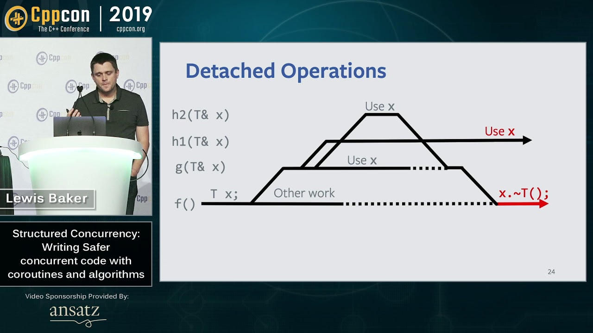

State of the art solution so far: lazy tasks
Use cppcoro by Lewis Baker *
https://github.com/lewissbaker/cppcoro
https://youtu.be/1Wy5sq3s2rg

Slide 68

You may want to watch

Slide 69

Thanks for listening!

Slide 70

Understanding C++ coroutines by example part 1
Pavel Novikov
@cpp_ape
Thanks to Lewis Baker for feedback!
I owe you beer
Slides: https://bit.ly/3ulr5Ta

Slide 71
References
Lewis Baker "Structured Concurrency: Writing safer concurrent code with coroutines and algorithms" https://youtu.be/1Wy5sq3s2rg
P2506: std::lazy: a coroutine for deferred execution http://wg21.link/p2506

Slide 72
Bonus slides

Slide 73
getAwaitable()
template<typename T>
auto getAwaitableImpl(T &&a, int) ->
decltype(std::forward<T>(a).operator co_await()) {
return std::forward<T>(a).operator co_await();
}
template<typename T>
auto getAwaitableImpl(T &&a, long) ->
decltype(operator co_await(std::forward<T>(a))) {
return operator co_await(std::forward<T>(a));
}
template<typename T, typename U>
T &&getAwaitableImpl(T &&a, U) {
return static_cast<T&&>(a);
}
template<typename T>
auto getAwaitable(T &&a) {
return getAwaitableImpl(a, 42);
}

Slide 74
ResultOfAwait<T>
template<typename T>
using ResultOfAwait =
std::decay_t<decltype(
getAwaitable(std::declval<T>()).await_resume()
)>;

Slide 75
tid
struct TidMark {
friend
std::ostream &operator<<(std::ostream &s, TidMark) {
s << "(tid=" << std::this_thread::get_id() << ')';
return s;
}
} const tid;
std::cout << tid;

Slide 76
State machine using coroutines
Events:
struct Open {};
struct Close {};
struct Knock {};
enum class State {
Closed,
Open
};
struct Door {
State state = State::Closed;
template<typename E>
void onEvent(E);
};

Slide 77
State machine using coroutines
switch
void onEvent(E) {
switch (state) {
case State::Closed:
if constexpr (isSame<E, Open>) {
state = State::Open;
}
else if constexpr (isSame<E, Knock>) {
shout("Come in, it's open!"); // no transition
}
break;
case State::Open:
if constexpr (isSame<E, Close>)
state = State::Closed;
}
}

Slide 78
State machine using coroutines
switch
Door door;
door.onEvent(Open{}); // Closed -> Open
door.onEvent(Close{}); // Open -> Closed
door.onEvent(Knock{});
door.onEvent(Close{}); // Closed -> Closed
output:
Come in, it's open!

Slide 79
State machine using coroutines
StateMachine getDoor() {
for (;;) {
//closed
auto e = co_await Event<Open, Knock>{};
if (std::holds_alternative<Knock>(e)) {
shout("Come in, it's open!");
}
else if (std::holds_alternative<Open>(e)) {
// open
co_await Event<Close>{};
}
}
}

Slide 80
State machine using coroutines
StateMachine getDoor() {
closed:
for (;;) {
auto e = co_await Event<Open, Knock>{};
if (std::holds_alternative<Knock>(e)) {
shout("Come in, it's open!");
}
else if (std::holds_alternative<Open>(e)) {
goto open;
}
}
open:
co_await Event<Close>{};
goto closed;
}

Slide 81
State machine using coroutines
template<typename... Events>
struct Event {};
struct StateMachine {
struct promise_type;
template<typename E>
void onEvent(E e);
~StateMachine() { coro.destroy(); }
StateMachine(const StateMachine &) = delete;
StateMachine &operator=(const StateMachine &) = delete;
private:
StateMachine(std::coroutine_handle<promise_type> coro) : coro{ coro } {}
std::coroutine_handle<promise_type> coro;
};

Slide 82
State machine using coroutines
struct promise_type {
using CoroHandle = std::coroutine_handle<promise_type>;
StateMachine get_return_object() noexcept {
return { CoroHandle::from_promise(*this) };
}
std::suspend_never initial_suspend() const noexcept { return {}; }
std::suspend_always final_suspend() const noexcept { return {}; }
template<typename... E>
auto await_transform(Event<E...>) noexcept;
void return_void() noexcept {}
void unhandled_exception() noexcept {}
std::any currentEvent;
bool (*isWantedEvent)(const std::type_info&) = nullptr;
};

Slide 83
StateMachine::promise_type
template<typename... E>
auto await_transform(Event<E...>) noexcept {
isWantedEvent = [](const std::type_info &type)->bool {
return ((type == typeid(E)) || ...);
};
struct Awaitable { /*...*/ };
return Awaitable{ &currentEvent };
}

Slide 84
StateMachine::promise_type
struct Awaitable {
bool await_ready() const noexcept { return false; }
void await_suspend(CoroHandle) noexcept {}
std::variant<E...> await_resume() const {
std::variant<E...> event;
(void)((
currentEvent->type() == typeid(E) ?
(event = std::move(*std::any_cast<E>(currentEvent)), true) :
false
) || ...);
return event;
}
const std::any *currentEvent;
};

Slide 85
State machine using coroutines
struct StateMachine {
//...
template<typename E>
void onEvent(E &&e) {
auto &promise = coro.promise();
if (promise.isWantedEvent(typeid(E))) {
promise.currentEvent = std::forward<E>(e);
coro();
}
}
//...
};

Slide 86
State machine using coroutines
auto door = getDoor();
door.onEvent(Open{}); // Closed -> Open
door.onEvent(Close{}); // Open -> Closed
door.onEvent(Knock{});
door.onEvent(Close{}); // Closed -> Closed
output:
Come in, it's open!

Slide 87
State machine using coroutines
StateMachine getDoor(std::string answer) {
closed:
for (;;) {
auto e = co_await Event<Open, Knock>{};
if (std::holds_alternative<Knock>(e)) {
shout(answer);
}
else if (std::holds_alternative<Open>(e)) {
goto open;
}
}
open:
co_await Event<Close>{};
goto closed;
}

Slide 88
State machine using coroutines
auto door = getDoor("Occupied!");
door.onEvent(Open{}); // Closed -> Open
door.onEvent(Close{}); // Open -> Closed
door.onEvent(Knock{});
door.onEvent(Close{}); // Closed -> Closed
output:
Occupied!

